Slide 1
Capstone Engagement
Assessment, Analysis, and Hardening of a Vulnerable System

Slide 2
Table of Contents
This document contains the following sections:
01
Network Topology
02
Red Team: Security Assessment
03
Blue Team: Log Analysis and Attack Characterization
Hardening: Proposed Alarms and Mitigation Strategies
04

Slide 3
Network Topology
3

Slide 4
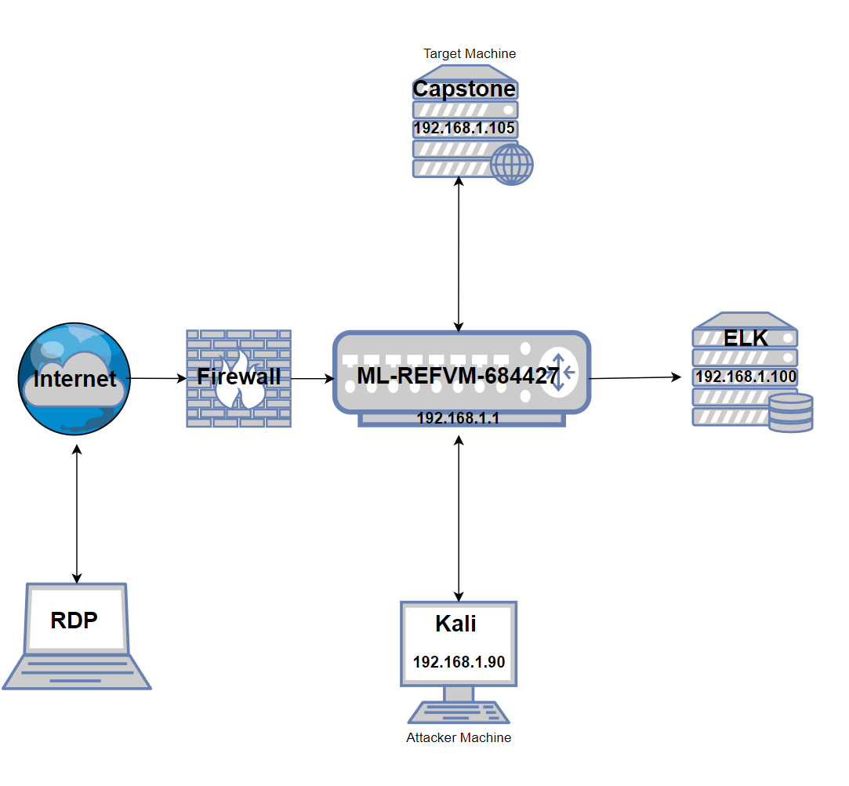
Network Topology
Network
Address Range: 192.168.1.0/24
Netmask: 192.168.1.255
Gateway: 192.168.1.1
Machines
IPv4: 192.168.1.105
OS: Linux
Hostname: Capstone
IPv4: 192.168.1.90
OS: Linux
Hostname: Kali
IPv4: 192.168.1.100
OS: Linux
Hostname: ELK
IPv4: 192.168.1.1
OS: Windows
Hostname:
ML-REFVM-684427

Slide 5

Red Team
Security Assessment
5

Slide 6
Recon: Describing the Target
Nmap identified the following hosts on the network:
Hostname | IP Address | Role on Network
Capstone | 192.168.1.105 | Web Server (Target Machine)
Kali | 192.168.1.90 | Attacking Machine
ELK | 192.168.1.100 | ELK Machine
ML-REFVM-684427 | 192.168.1.1 | Hyper V

Slide 7
Vulnerability Assessment
The assessment uncovered the following critical vulnerabilities in the target:
Vulnerability | Description | Impact
BRUTE FORCE (HYDRA) | Hydra bruteforces multiple passwords in an attempt to get a users login | Allows the attacker to brute force a users login credentials
CRACKSTATION (HASH CRACKER) | Crackstation allows you to crack hash passwords | Allows attackers to gain access to sensitive credentials
REVERSE SHELL (METERPRETER EXPLOIT) | Reverse Shell allows us to exploit the system | Allows the attacker to listen to the target machine, access to machine

Slide 8
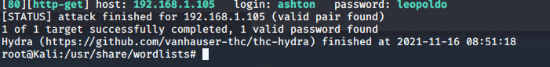
Exploitation: Brute Force (HYDRA)
01
02
03
Tools & Processes
How did you exploit the vulnerability?
Located the /secret_folder/ which gave me the user login name which was “ashton”.
Used hydra command to brute force ashton’s password
Achievements
What did the exploit achieve?
This exploit gave me the password to access user: ashton
hydra -l ashton -P /usr/share/wordlists/rockyou.txt -s 80 -f -vV 192.168.1.105 http-get /company_folders/secret_folder/

Slide 9
Exploitation: Crackstation (Hash Cracker)
01
02
03
Tools & Processes
How did you exploit the vulnerability?
Once I gained access to the /secret_folder/, the file /connect_to_corp_server gave me instructions how to get into ryan’s account
Achievements
What did the exploit achieve?
This exploit allowed me to crack ryan’s password who is the CEO and allowed me create the reverse shell
Hash:
d7dad0a5cd7c8376eeb50d69b3ccd352
linux4u

Slide 10
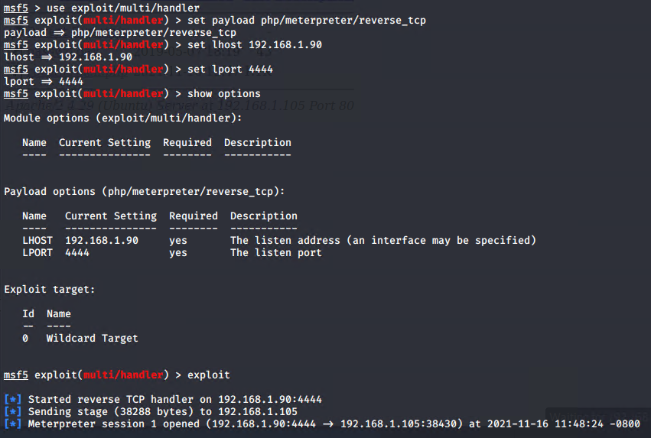
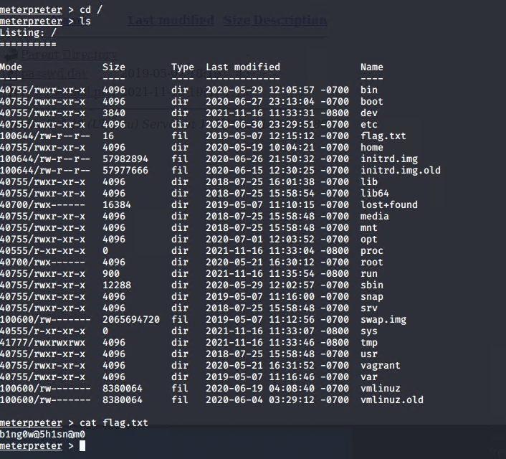
Exploitation: Reverse Shell (Meterpreter Exploit)
01
02
03
Tools & Processes
How did you exploit the vulnerability?
Msfvenom to write the payload
Reverseshell TCP
Msfconsole
Meterpreter to exploit
Achievements
What did the exploit achieve?
Access to Capstone Machine to find the flag.txt

Slide 11

Blue Team
Log Analysis and Attack Characterization
11

Slide 12

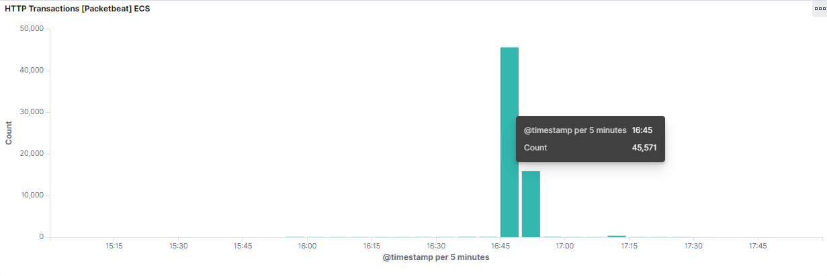
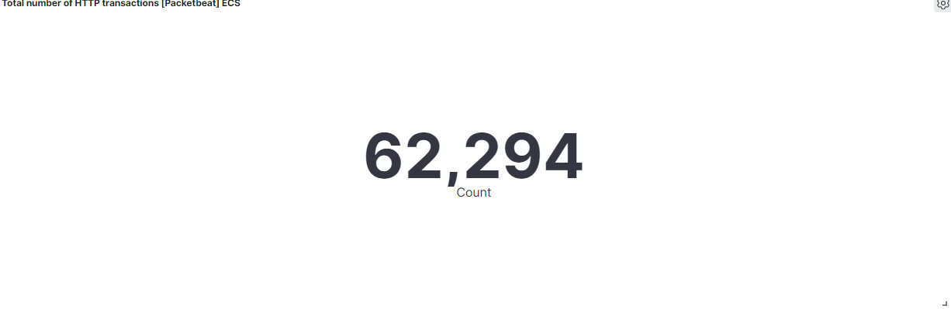
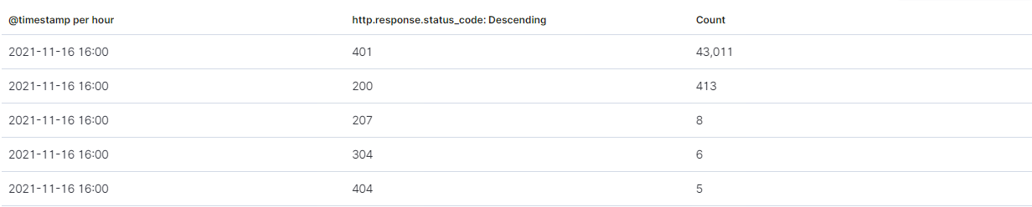
Analysis: Identifying the Port Scan
Answer the following questions in bullet points under the screenshot if space allows. Otherwise, add the answers to speaker notes.
What time did the port scan occur? 16:42
How many packets were sent, and from which IP? 62,294
What indicates that this was a port scan? Large amount of packets in a short time

Slide 13
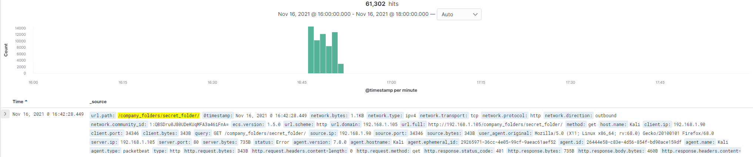
Analysis: Finding the Request for the Hidden Directory
Answer the following questions in bullet points under the screenshot if space allows. Otherwise, add the answers to speaker notes.
What time did the request occur? 16:42
How many requests were made? 61,302
Which files were requested? GET Status Code What did they contain? Password for ashton

Slide 14
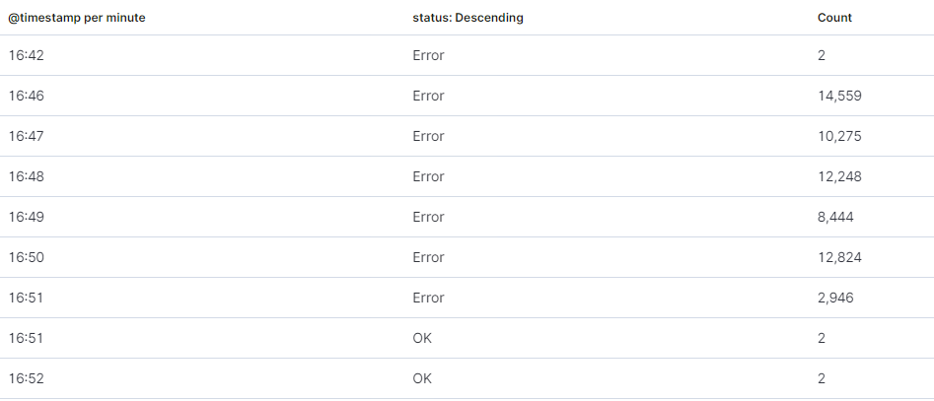
Analysis: Uncovering the Brute Force Attack
Answer the following questions in bullet points under the screenshot if space allows. Otherwise, add the answers to speaker notes.
How many requests were made in the attack? 61,302
How many requests had been made before the attacker discovered the password? 61,298

Slide 15
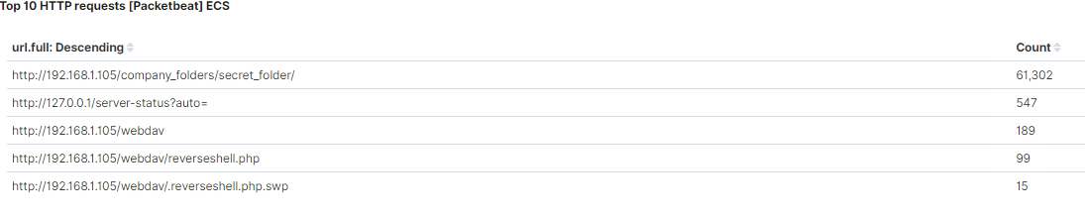

Analysis: Finding the WebDAV Connection
Answer the following questions in bullet points under the screenshot if space allows. Otherwise, add the answers to speaker notes.
How many requests were made to this directory? 189
Which files were requested? reverseshell.php

Slide 16
Blue Team
Proposed Alarms and Mitigation Strategies
16

Slide 17
Mitigation: Blocking the Port Scan
What kind of alarm can be set to detect future port scans?
Alert SOC analyst when a port is being scanned numerous times by the same IP address
What threshold would you set to activate this alarm?
The threshold would be if the port is being scanned more than 100 times in 30 seconds
What configurations can be set on the host to mitigate port scans?
Close port 80 when not being used or only allow whitelisted IP address to use port 80
Describe the solution. If possible, provide required command lines.
Honeypots can divert attackers to think they have access to the system while administrator monitors their activity

Slide 18
Mitigation: Finding the Request for the Hidden Directory
What kind of alarm can be set to detect future unauthorized access?
Alert SOC Analyst whenever /secret_folder/ is being accessed from unauthorized IP address’
What threshold would you set to activate this alarm?
The threshold would be if an non whitelisted IP address access’ the folder
What configuration can be set on the host to block unwanted access?
Only allow whitelisted IP address’ to access /secret_folder/
Describe the solution. If possible, provide required command lines.
Remove the information in the /company_folders/ indicating that there is a /secret_folder/

Slide 19
Mitigation: Preventing Brute Force Attacks
What kind of alarm can be set to detect future brute force attacks?
Alert SOC Analyst whenever Hydra is seen in the logs or when multiple login errors are seen within a short time span
What threshold would you set to activate this alarm?
The threshold would be whenever more than 15 failed attempts
What configuration can be set on the host to block brute force attacks?
Password lockouts:
5 failed attempts – 10 mins
10 failed attempts – 30 mins
15 failed attempts – 1 hour
20 failed attempts – contact admin
Describe the solution. If possible, provide the required command line(s).
Use 2 Factor Authentication
Use Captcha

Slide 20
Mitigation: Detecting the WebDAV Connection
What kind of alarm can be set to detect future access to this directory?
Alert SOC Analysts whenever webdav is being accessed from non whitelisted IP’s
What threshold would you set to activate this alarm?
The threshold would be if any IP address other than the admin is used
What configuration can be set on the host to control access?
Only allow SSH login from admin IP address
Describe the solution. If possible, provide the required command line(s).
SSH Login or 2FA

Slide 21
Mitigation: Identifying Reverse Shell Uploads
What kind of alarm can be set to detect future file uploads?
Alert SOC Analyst whenever a .php is uploaded
What threshold would you set to activate this alarm?
The threshold would be whenever a .php is being used
What configuration can be set on the host to block file uploads?
Only allow admin IP access to webdav and write privileges only to admin accounts
Describe the solution. If possible, provide the required command line.
Require authentication to upload files

